Slide 1

TMEDS Discovery Meeting: Basics of flow data analysis John Quinn Ph.D. Director of Science and Product Development BDB Informatics (FlowJo) john.flowjo@bd.com

Slide 2
Outline
Details of an FCS file
Controls
Compensation Options
Transforms
Population Identification
Reporting
High-dimensional analysis

Slide 3
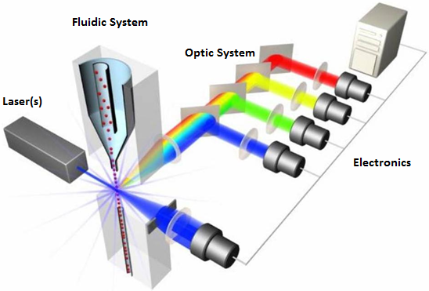
Cytometers

Slide 4

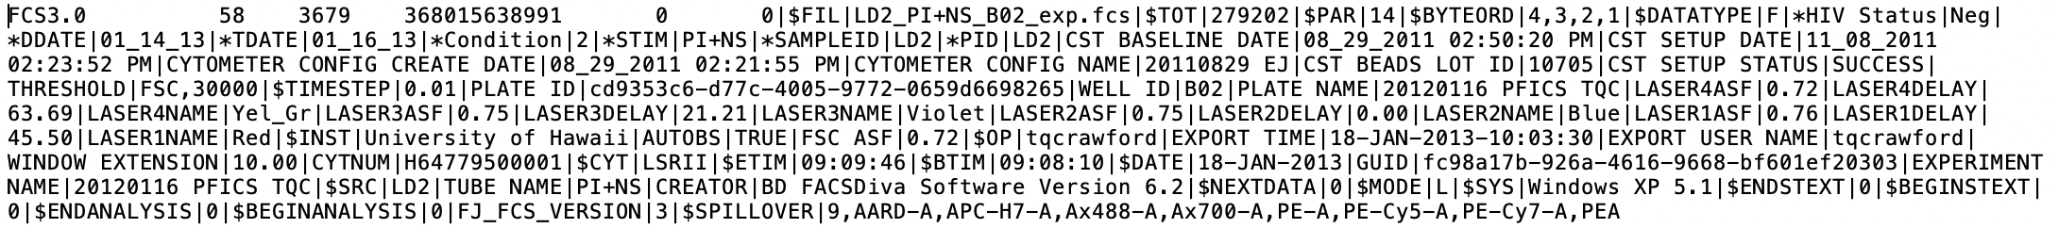
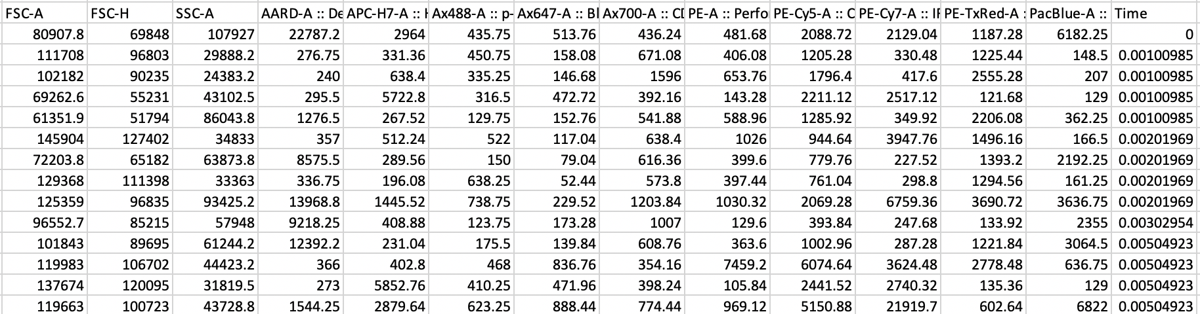
Details of an FCS File
Features
FCS = Flow Cytometry Standard
Keywords
Cells
List Mode Data

Slide 5
Controls
Start with a biological question
Phrase it as a null hypothesis
This will determine what controls are needed

Slide 6
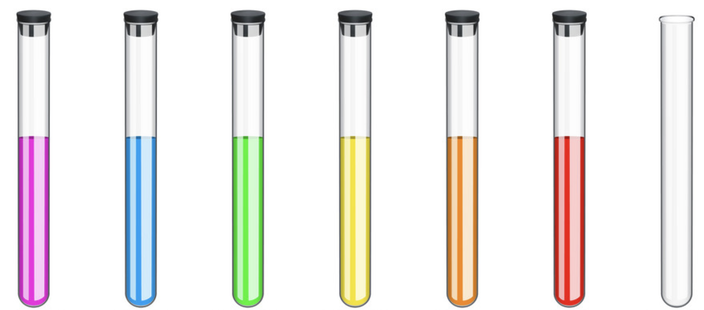
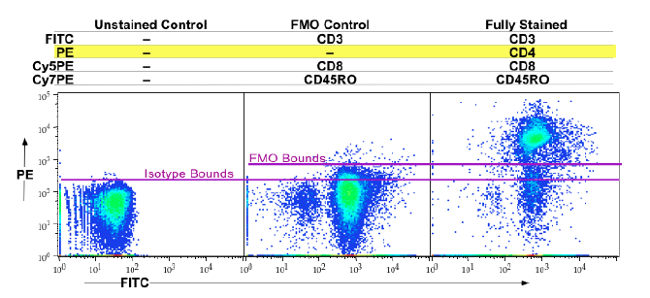
Types of Controls
Instrument set up
Compensation
Gating
Unstained cells
Florescence Minus One (FMO)
Experimental
Isotype (optional)

Slide 7

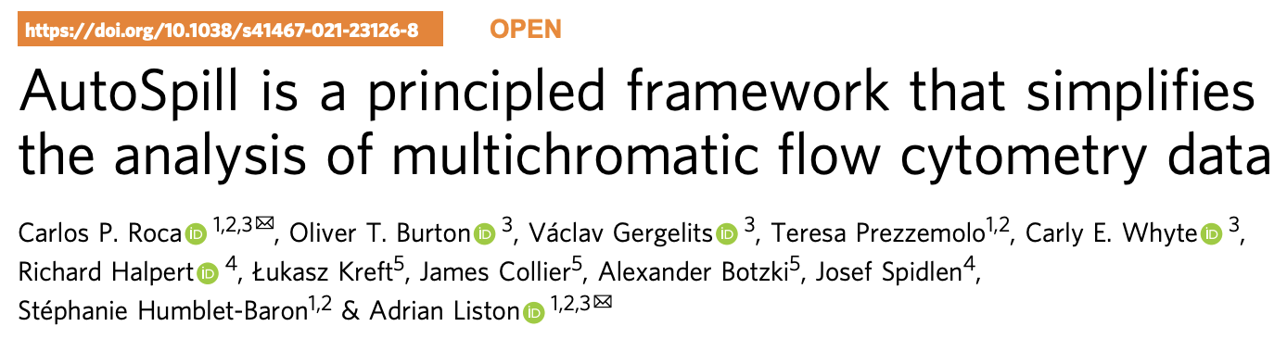
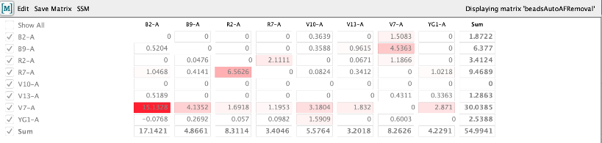
Compensation Options
Acquisition vs. Post-acquisition
Traditional vs. Spectral
Gate-based vs. AutoSpill
Beads vs. Cells
SSM vs. TSM
Calculate SSM/ TSM

Slide 8
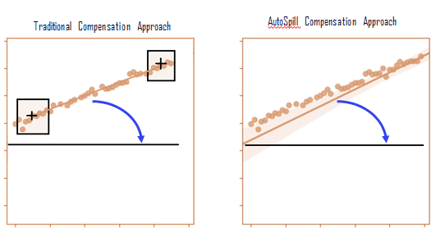
AutoSpill
Robust linear regression-based approach
No positive or negative populations needed
Overcomes some weak positive control samples
Iterative
Auto-fluorescence subtraction possible
Gate-based
AutoSpill

Slide 9
Transforms
Linear
Logarithmic
Logical

Slide 10
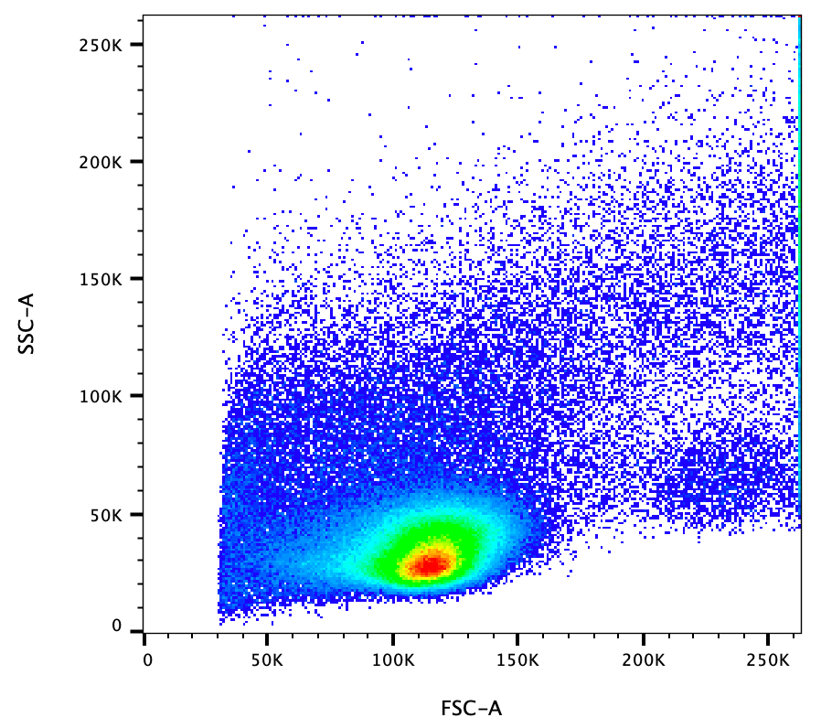
Transforms
Linear
Logarithmic
Logical

Slide 11
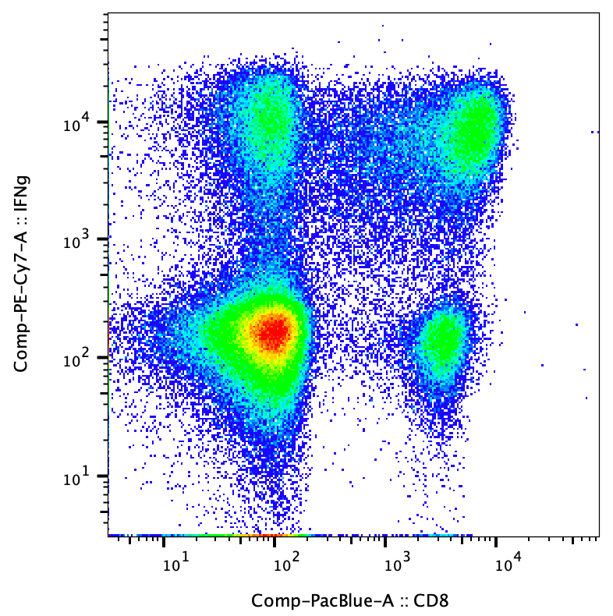
Transforms
Linear
Log
Logical

Slide 12
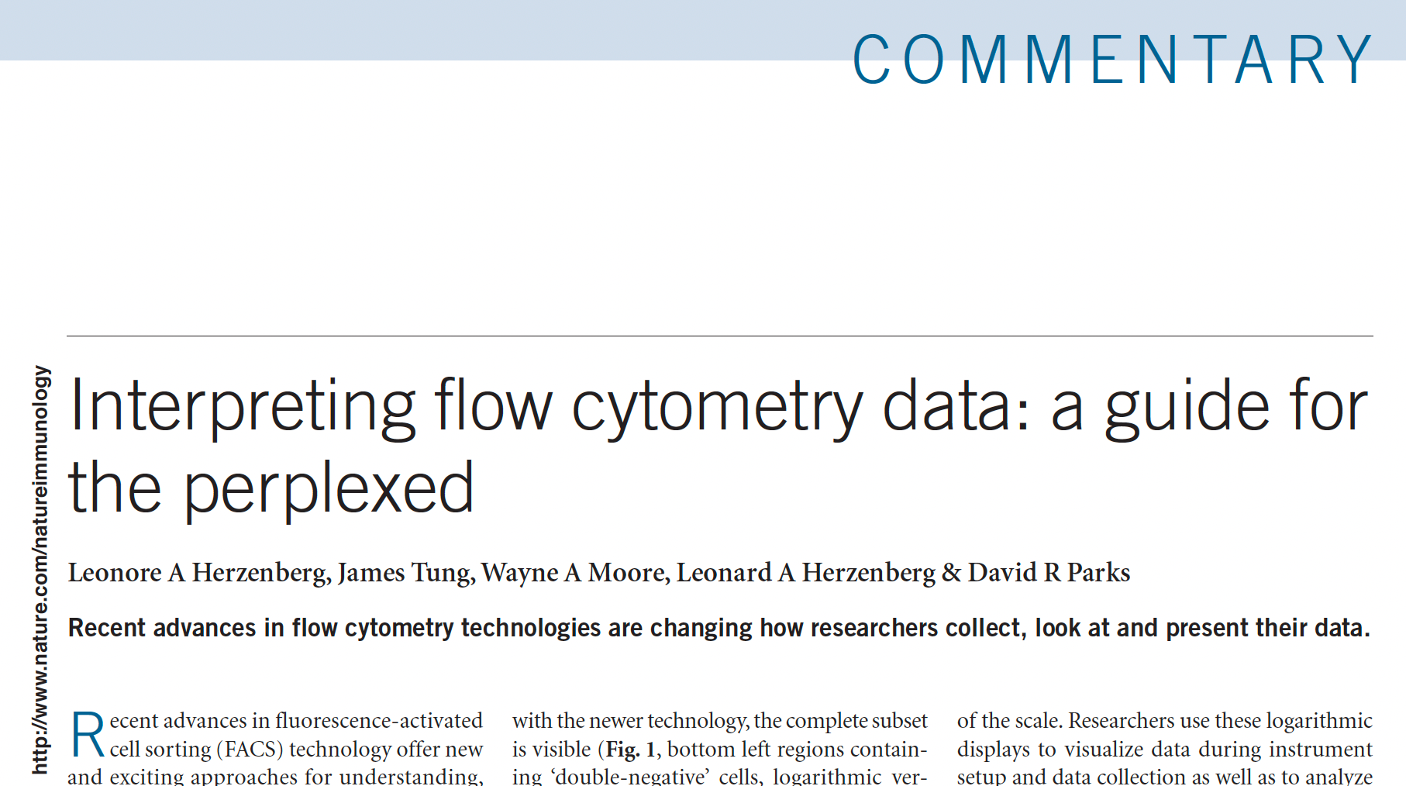
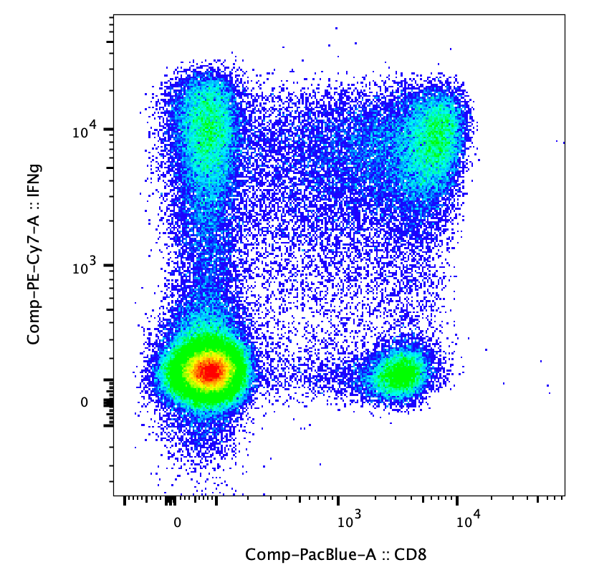
Transforms
Linear
Log
Logical
Bi-exponential
Hyperlog
Arcsin
Arcsinh

Slide 13
Population Identification
Preprocessing
Time
Doublets & Debris
Dead cells
Normalization (if necessary)
Identification

Slide 14
Clean up vs. time

Slide 15
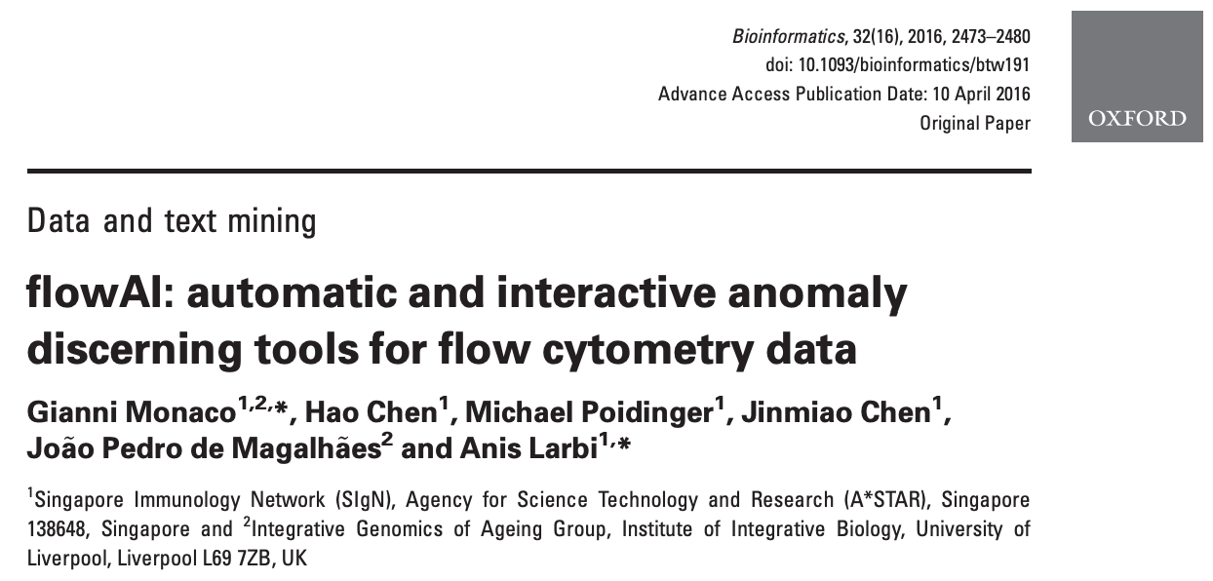
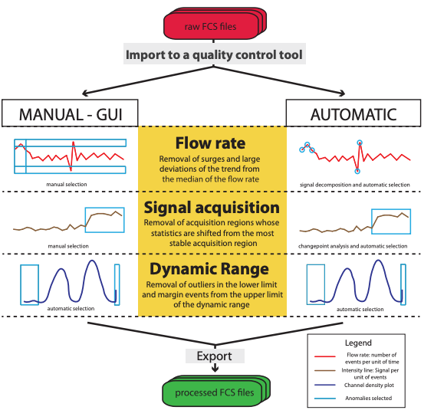
Time gating
Manual vs. Algorithms

Slide 16
Time gating
Manual vs. Algorithms
Save time, do a better job

Slide 17
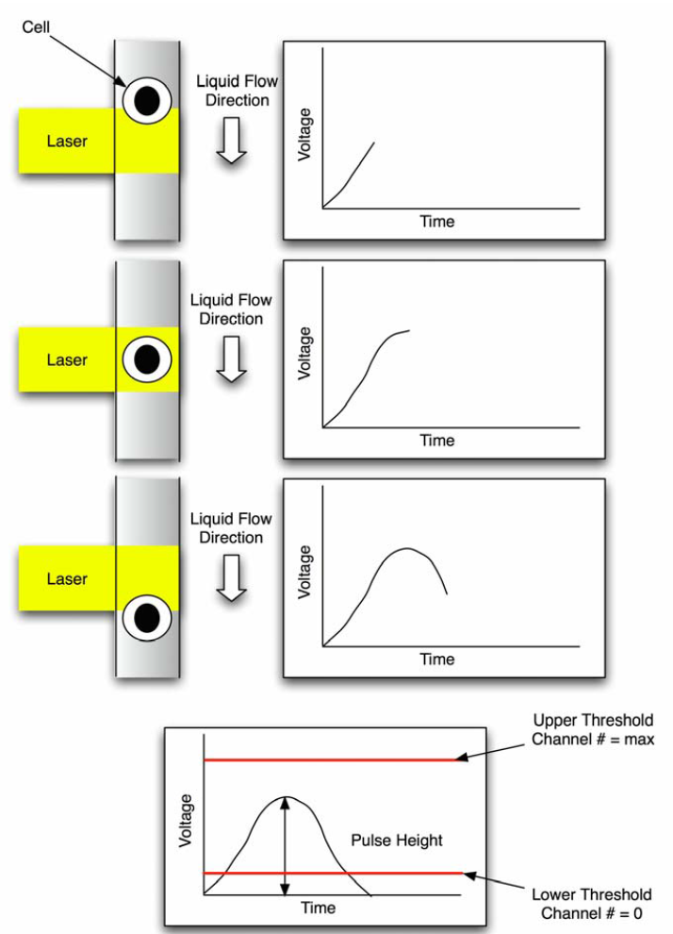
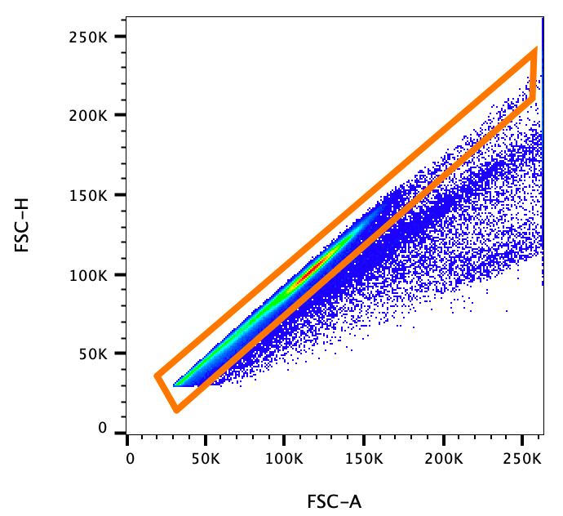
Doublet Discrimination

Slide 18
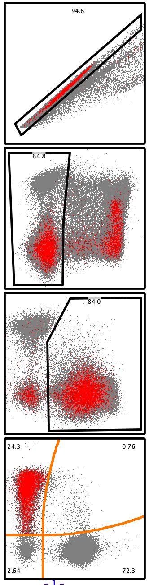
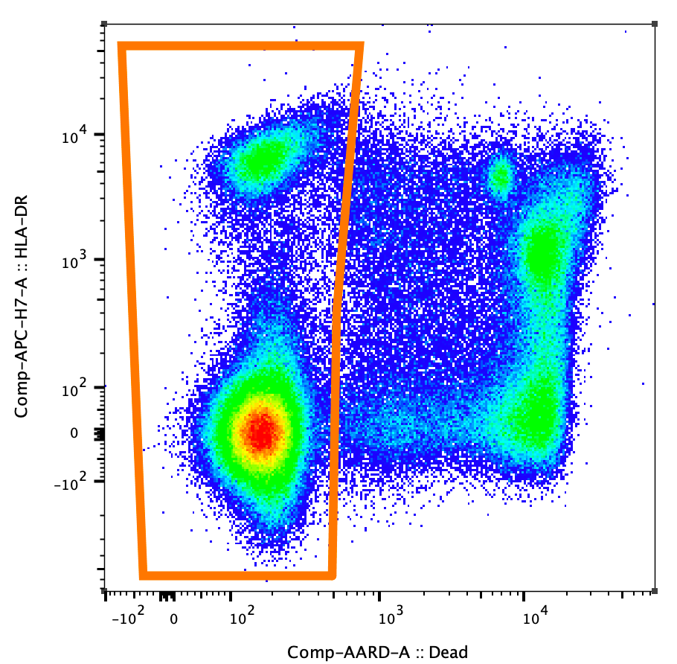
Live/Dead Discrimination
Backgating

Slide 19
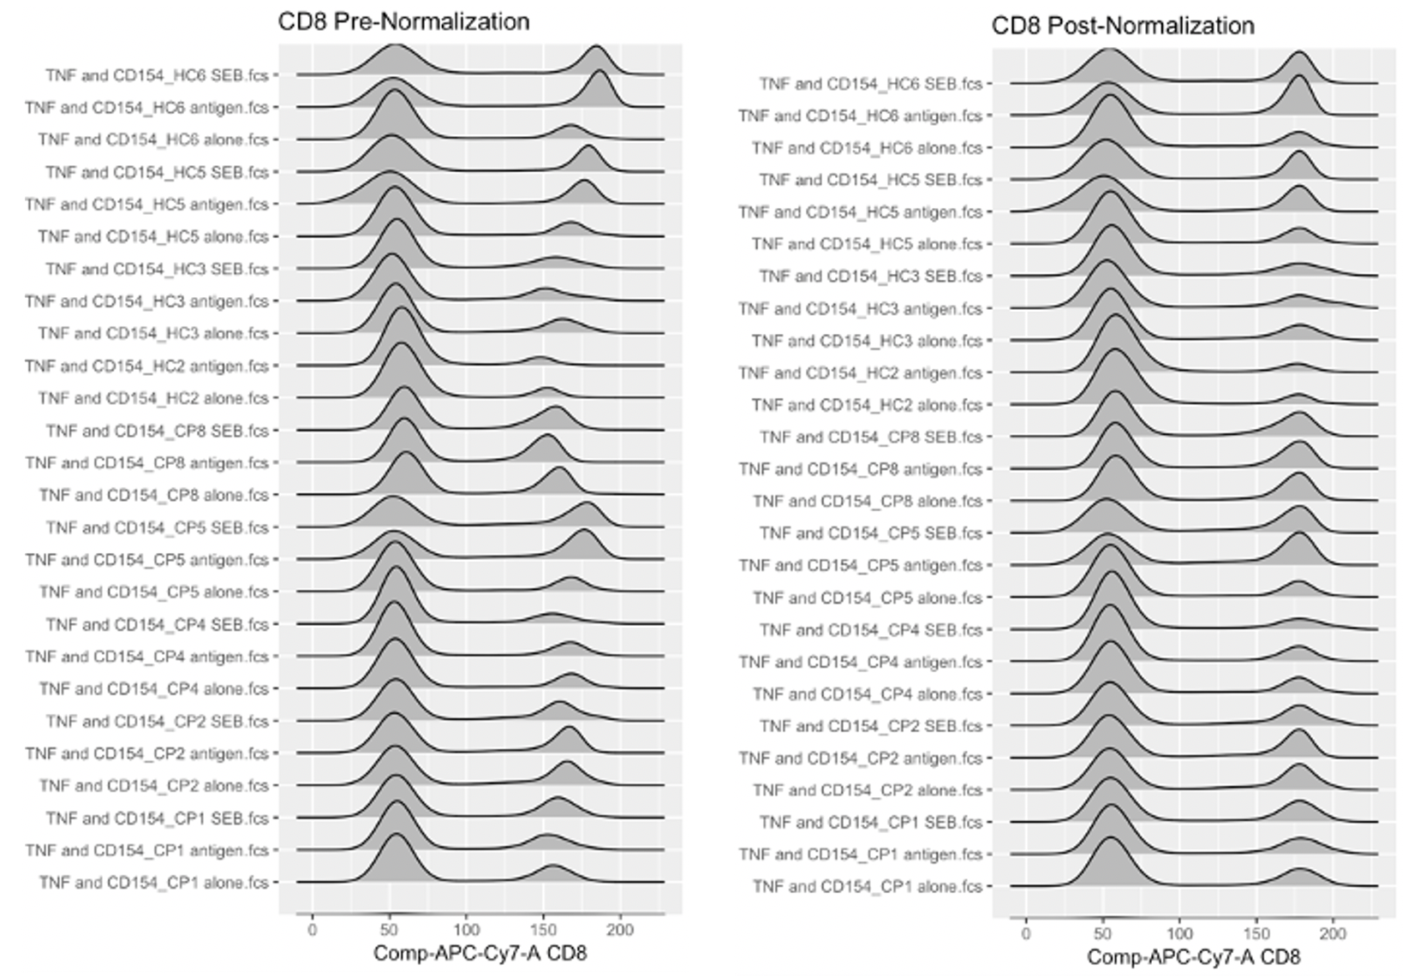
Normalization
Consideration for comparing data across acquisition runs
Via instrumentation
Possible post-acquisition

Slide 20
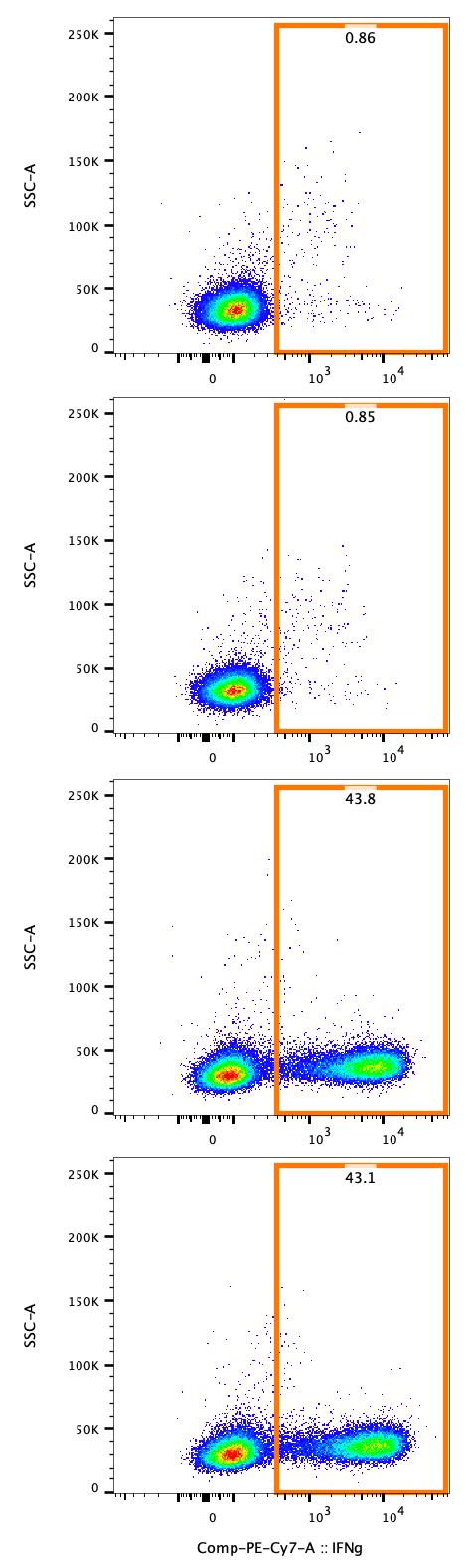
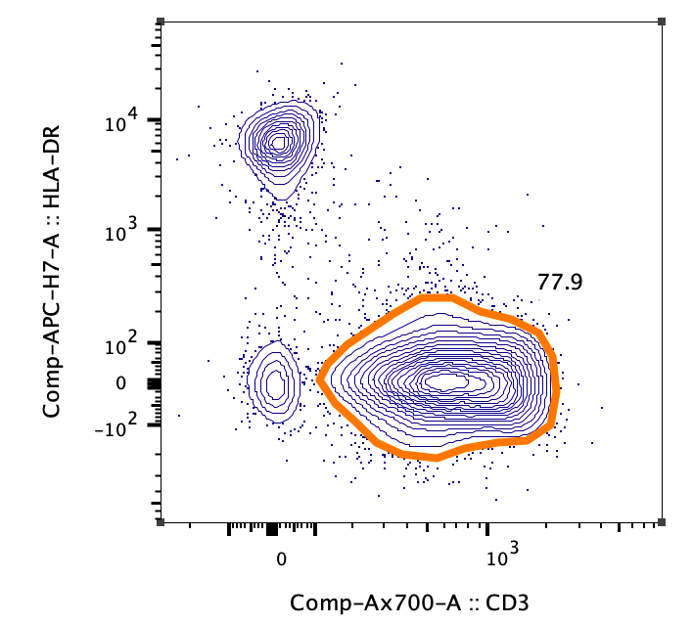
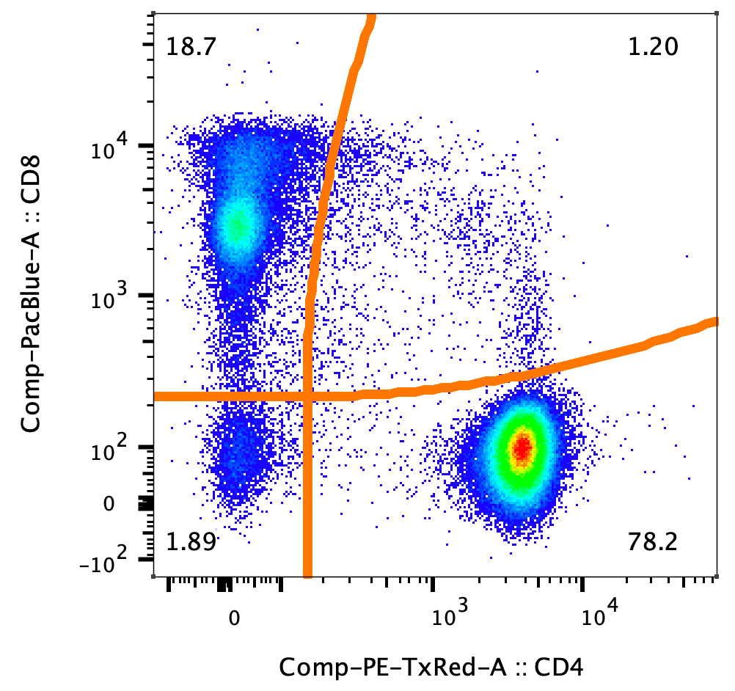
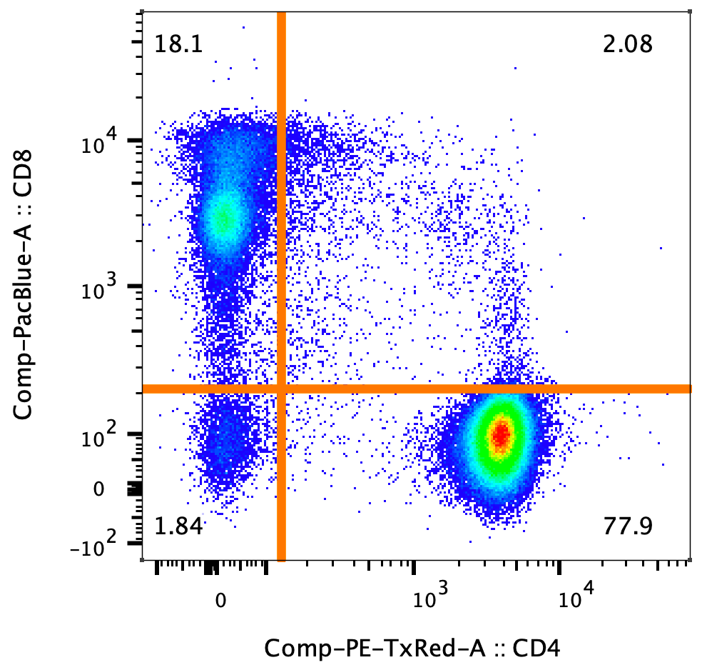
Manual gating
Best done in reference to unstained, FMO, or biological controls
Option include:
Threshold
Density based
Quads
Traditional
Curly

Slide 21
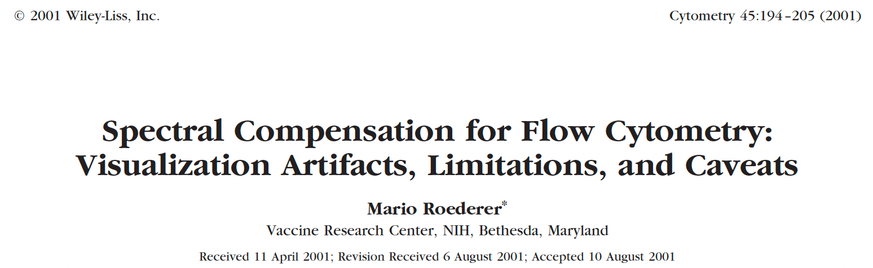
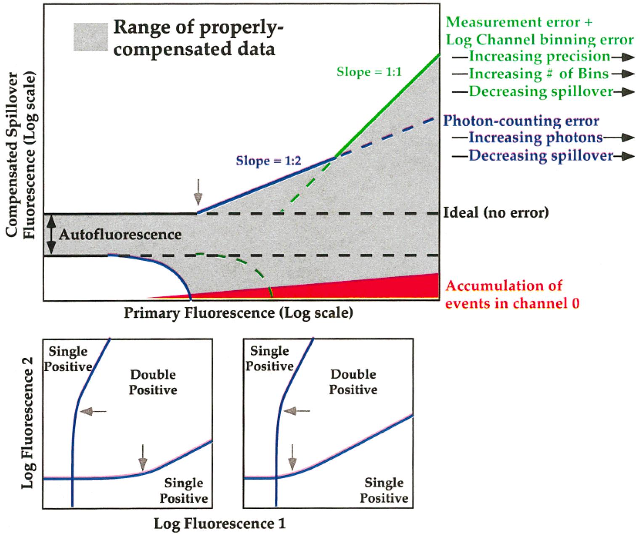
Spreading error
Photon counting statistics
More ‘positive’ data will have increased spread

Slide 22
Automated Workflow
Data Clean up
Dimension Reduction
Auto-gating
Population identification
FlowAI
FlowClean
CytoNorm
MNN norm
tSNE
UMAP
PacMap
EmbedSOM
FlowSOM
PhenoGraph
XShift
DaFi
Cluster Explorer
Euclid
Violin & Box
TREX
BD and FlowJo are one! Supporting you and your research from design to discovery.
Notes:
Highlighted: an exemplar of the major classes

Slide 23
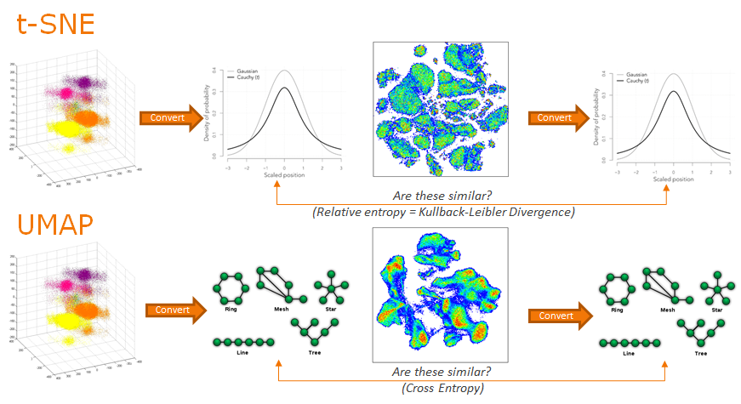
Dimensionality Reduction Comparison
Notes:
tSNE, perhaps the most famous DR technique among cool people / cytometrists, is a probability-based approach. Using the multi-parametric distance between each pair of data points, it constructs probability distributions of which cell would be considered the nearest neighbor of the currently considered cell. It then does the same thing on a low dimensional version of the data, and keeps iterating until those probabilities match, i.e. it has placed each cell with its neighbors.
UMAP is an example of a manifold approach. UMAP attempts to represent the data as a whole, as a structure or composite of simpler structures. It then tries to make a low dimensional representation of these structures that fit the data in 2D space and keeps iterating until the two representations align.

Slide 24
Clustering Options
Phenograph – Nearest Neighbors Graph
FlowSOM – Self Organizing Map
X-Shift – Fast KNN Density Estimation
Phenograph
FlowSOM
X-Shift
For Research Use Only. Not for use in therapeutic or diagnostic procedures.

Slide 25
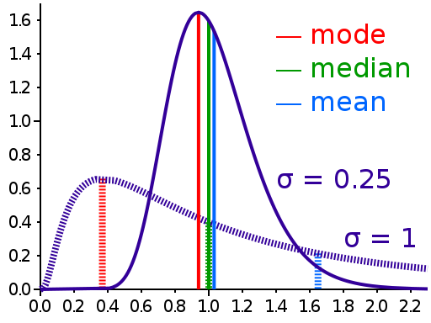
Reporting
When you say “MFI”…
Central tendency vs. increase in relative number of events

Slide 26
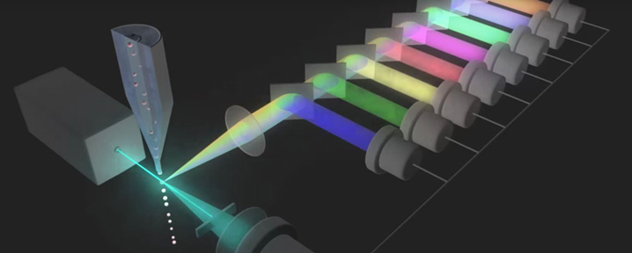
Questions?

